Slide 1




Iris Data Set

Slide 2
Answering Questions:
How to accurately predict the species of iris flower. | Building a machine learning template and using the correct formulas to classify the characteristics of the flower.
Why use the Iris Data Set to test the value of a machine learning program? | The iris dataset has been around since 1936 and has been used as a dataset because of the predictability
What information is expected to learn about machine learning programs from this dataset? | How to properly predict the outcome and test those predictions.

Slide 3
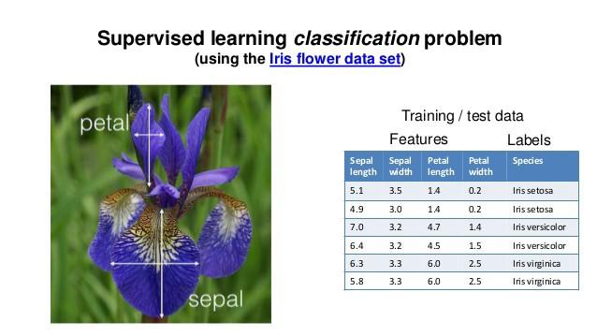
What is being measured in the data

Slide 4
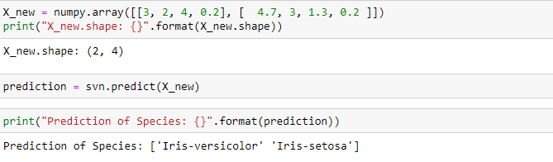
Predictions

Slide 5
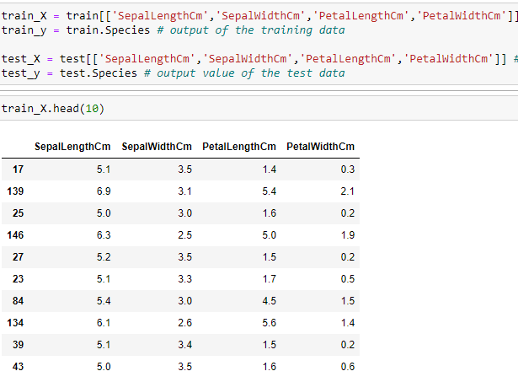
Test and Train Data

Slide 6
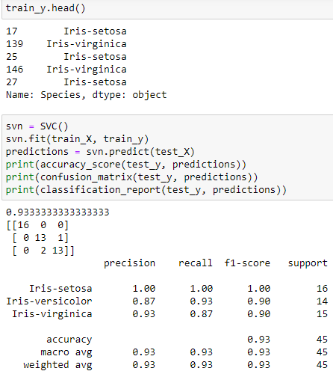

Slide 7
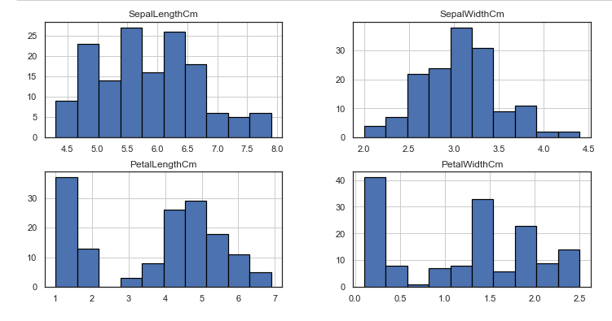

Slide 8
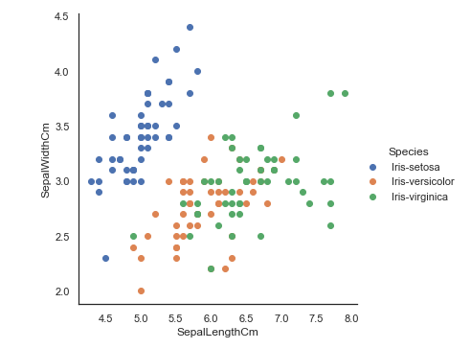
Seaborn Axis Grid
Notes:
Seaborn axis grid

Slide 9
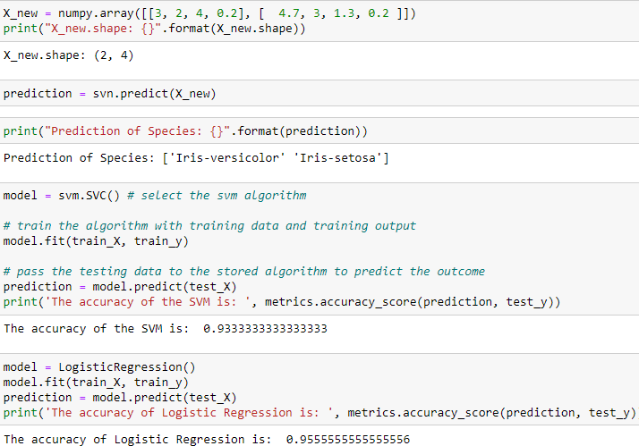
Notes:
Prediction

Slide 10
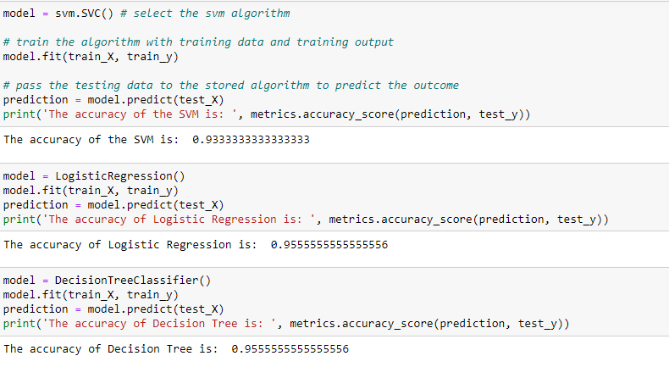

Slide 11
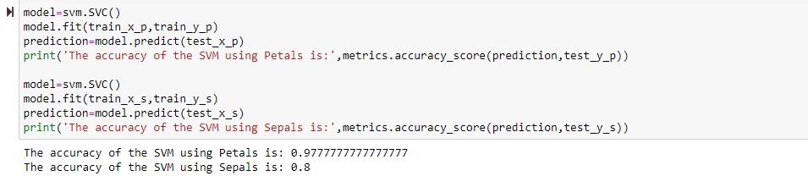
Support Vector Machine

Slide 12

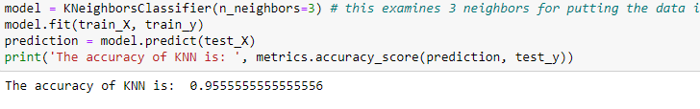
K-Nearest Neighbors

Slide 13
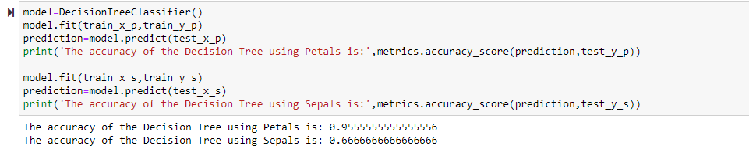
Decision Tree Classifier

Slide 15


